Slide 1

Package, Interface and Exception Handling
24CSP012- Java Programming
Notes:
Academic notes for: . This slide should be explained with focus on departmental academic performance, governance, and advisory inputs.

Slide 2

Packages in Java

Slide 3
What is a Package?
A package is a namespace that organizes related classes and interfaces.
Helps avoid class name conflicts.
Makes locating and using classes easier.
Supports access protection and reusability.

Slide 4
Defining a Package
Use the 'package' keyword at the top of the file.
Place compiled class file inside corresponding folder.
package pkg
  Here, pkg is the name of the package
package mypackage
  creates a package called mypackage
The package statement defines a name space in which classes are stored
If you omit the package statement, the class names are put into the default package, which has no name

Slide 5
Declaring a Package
Java uses file system directories to store packages
– the .class files for any classes that are part of mypackage must be stored in a directory called mypackage
More than one file can include the same package statement
The package statement simply specifies to which package the classes defined in a file belong
To create hierarchy of packages, separate each package name from the one above it by use of a (.)

Slide 6
Package syntax
The general form of a multilevel package statement
  package pkg1[.pkg2[.pkg3]]
  package java.util.concurrent
import statements occur immediately following the package statement and before any class definitions
The general form of the import statement
  import pkg1 [.pkg2].(classname | *)
  import java.util.Scanner
  import statement is optional, class can be used with name that includes full package hierarchy

Slide 7
Package syntax
The general form of a multilevel package statement
  package pkg1[.pkg2[.pkg3]]
  package java.util.concurrent
import statements occur immediately following the package statement and before any class definitions
The general form of the import statement
  import pkg1 [.pkg2].(classname | *)
  import java.util.Scanner
  import statement is optional, class can be used with name that includes full package hierarchy

Slide 8

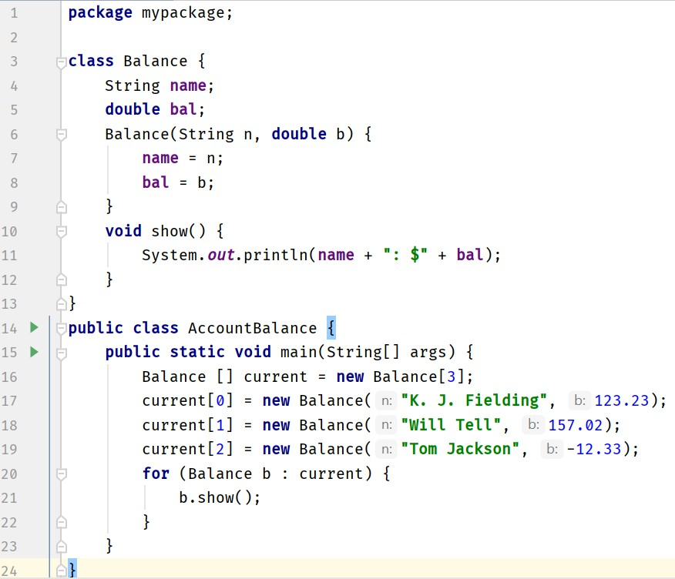
Package Example
javac -d . AccountBalance.java
java mypackage.AccountBalance

Slide 9
Access Protection
Packages act as containers for classes and other subordinate packages
Classes act as containers for data and code
The class is Java’s smallest unit of abstraction
Four categories of visibility for class members
  Subclasses in the same package
  Non-subclasses in the same package
  Subclasses in different package
  Classes that are neither in the same package nor subclasses
Notes:
Overview of new or updated electives.
Alignment with emerging technologies and industry requirements.

Slide 10
Access Protection
The three access modifiers provide a variety of ways to produce the many levels of access required
– private, public, and protected
The following applies only to members of classes
 | Private | No Modifier | Protected | Public
Same class | Yes | Yes | Yes | Yes
Same package subclass | No | Yes | Yes | Yes
Same package non-subclass | No | Yes | Yes | Yes
Different package subclass | No | No | Yes | Yes
Different package non-subclass | No | No | No | Yes
Notes:
Overview of new or updated electives.
Alignment with emerging technologies and industry requirements.

Slide 11
Access Protection
Anything declared public can be accessed from anywhere
Anything declared private cannot be seen outside of its class
When a member does not have an explicit access specification, it is visible to subclasses as well as to other classes in the same package (default access)
If you want to allow an element to be seen outside your current package, but only to classes that subclass the class directly, declare that protected
Notes:
Overview of new or updated electives.
Alignment with emerging technologies and industry requirements.

Slide 12
Access Protection
A non-nested class has only two possible access levels
– default and public (others are abstract and final)
When a class is declared as public, it is accessible by any other code
If a class has default access, then it can only be accessed by other code within its same package
When a class is public, it must be the only public class declared in the file, and the file must have the same name as the class
Notes:
Overview of new or updated electives.
Alignment with emerging technologies and industry requirements.

Slide 13
Interface

Slide 14
Interface
We can call it a pure abstract class having no concrete methods
  All methods declared in an interface are implicitly public
and abstract
  All variables declared in an interface are implicitly public, static and final
An interface can’t have instance variables, so can’t
maintain state information unlike class
A class can only extend from a single class, but a class can implement multiple interfaces
Notes:
Overview of new or updated electives.
Alignment with emerging technologies and industry requirements.

Slide 15
Implementing Interface
When you implement an interface method, it must be declared as public
By implementing an interface, a class signs a contract with the compiler that it will definitely provide implementation of all the methods
  If it fails to do so, the class will be considered as abstract
  Then it must be declared as abstract and no object of that class can be created
An abstract class specifies what an object is and an interface specifies what the object can do
Notes:
Overview of new or updated electives.
Alignment with emerging technologies and industry requirements.

Slide 16
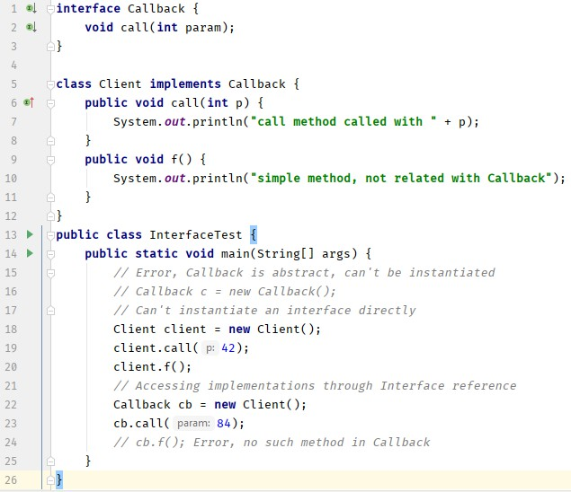
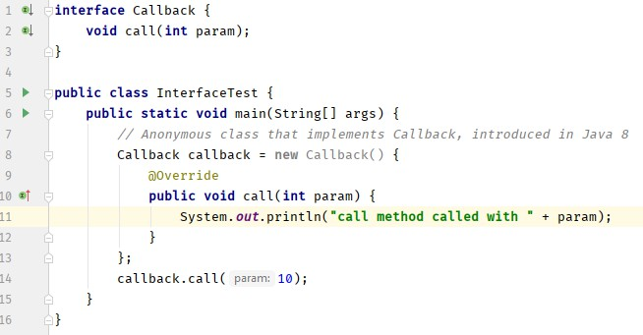
Simple Interface
Notes:
Overview of new or updated electives.
Alignment with emerging technologies and industry requirements.

Slide 17
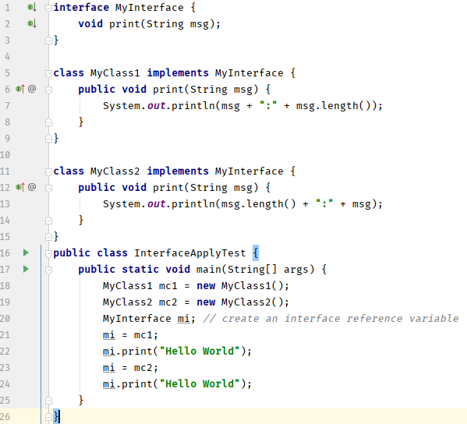
Applying Interface
Notes:
Overview of new or updated electives.
Alignment with emerging technologies and industry requirements.

Slide 18
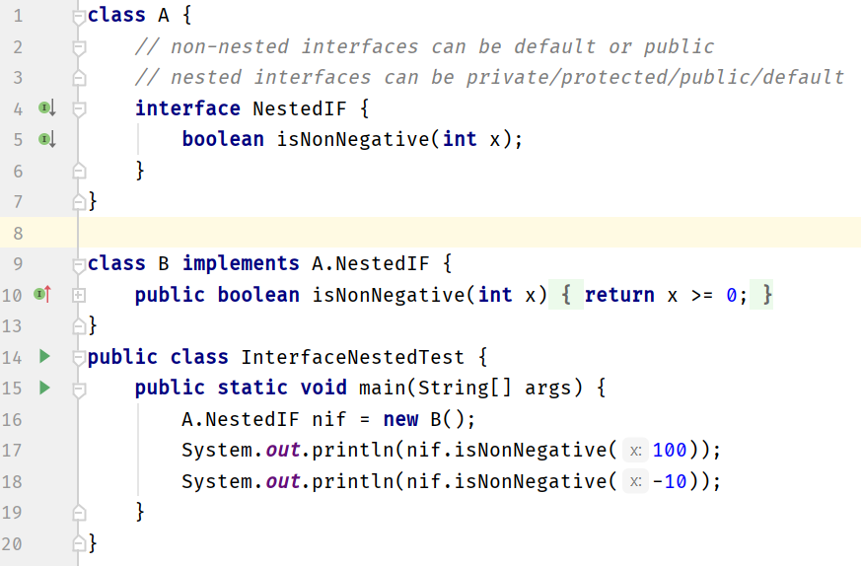
Nested or Member Interfaces
Notes:
Overview of new or updated electives.
Alignment with emerging technologies and industry requirements.

Slide 19
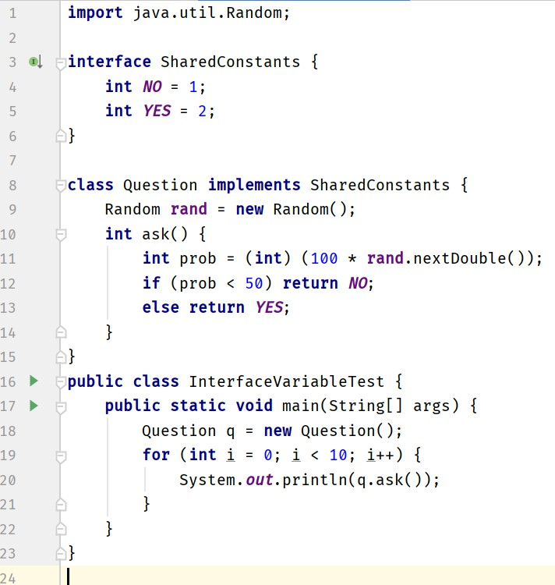
Variable in Interfaces
Notes:
Overview of new or updated electives.
Alignment with emerging technologies and industry requirements.

Slide 20
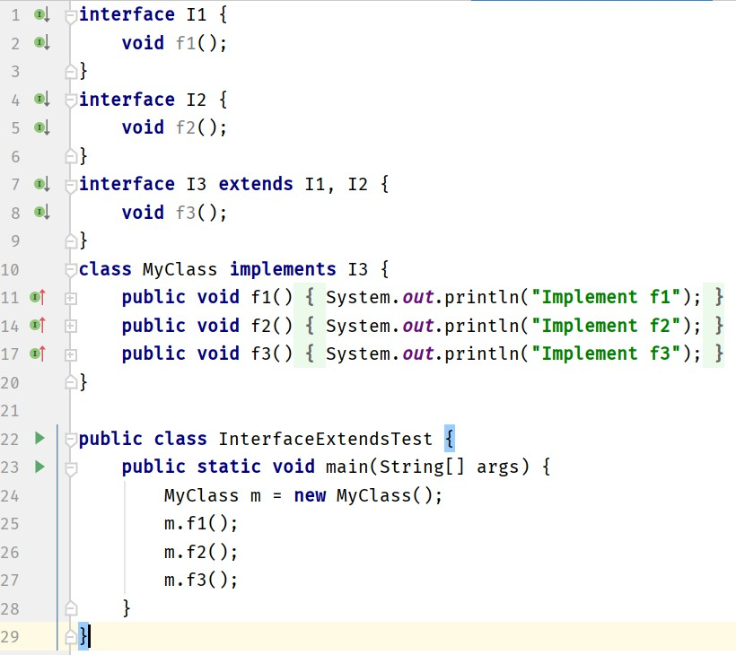
Extending Interfaces
Notes:
Overview of new or updated electives.
Alignment with emerging technologies and industry requirements.

Slide 21
Default Interface methods
Prior to Java 8, an interface could not define any implementation whatsoever
The release of Java 8 has changed this by adding a new capability to interface called the default method – A default method lets you define a default implementation
for an interface method
– Its primary motivation was to provide a means by which interfaces could be expanded without breaking existing code
Notes:
Overview of new or updated electives.
Alignment with emerging technologies and industry requirements.

Slide 22
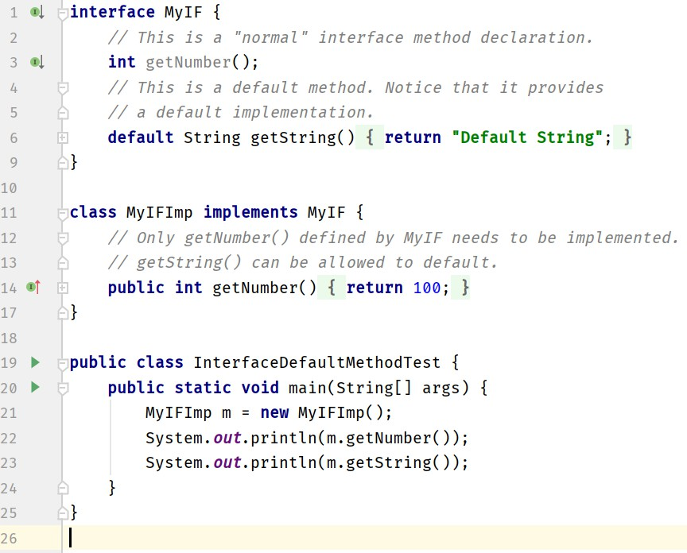
Default Interface methods
Notes:
Overview of new or updated electives.
Alignment with emerging technologies and industry requirements.

Slide 23
Default Interface methods
Notes:
Overview of new or updated electives.
Alignment with emerging technologies and industry requirements.

Slide 24
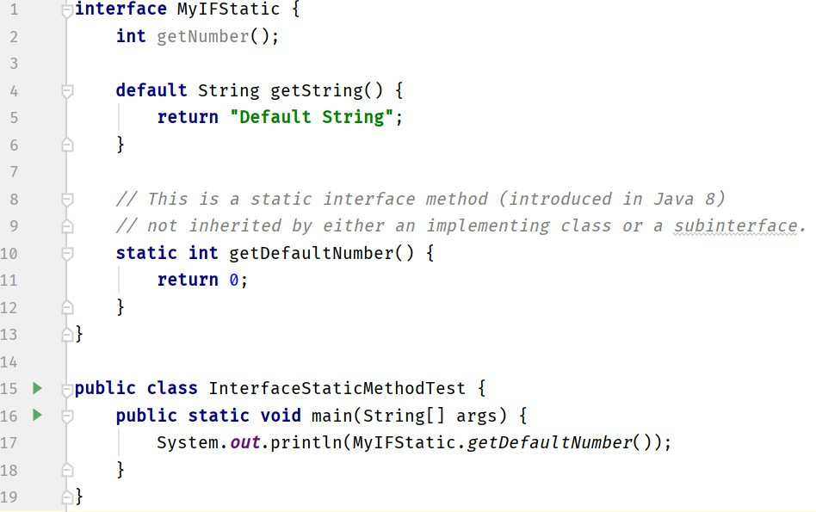
Static Methods in Interface
Notes:
Overview of new or updated electives.
Alignment with emerging technologies and industry requirements.

Slide 25
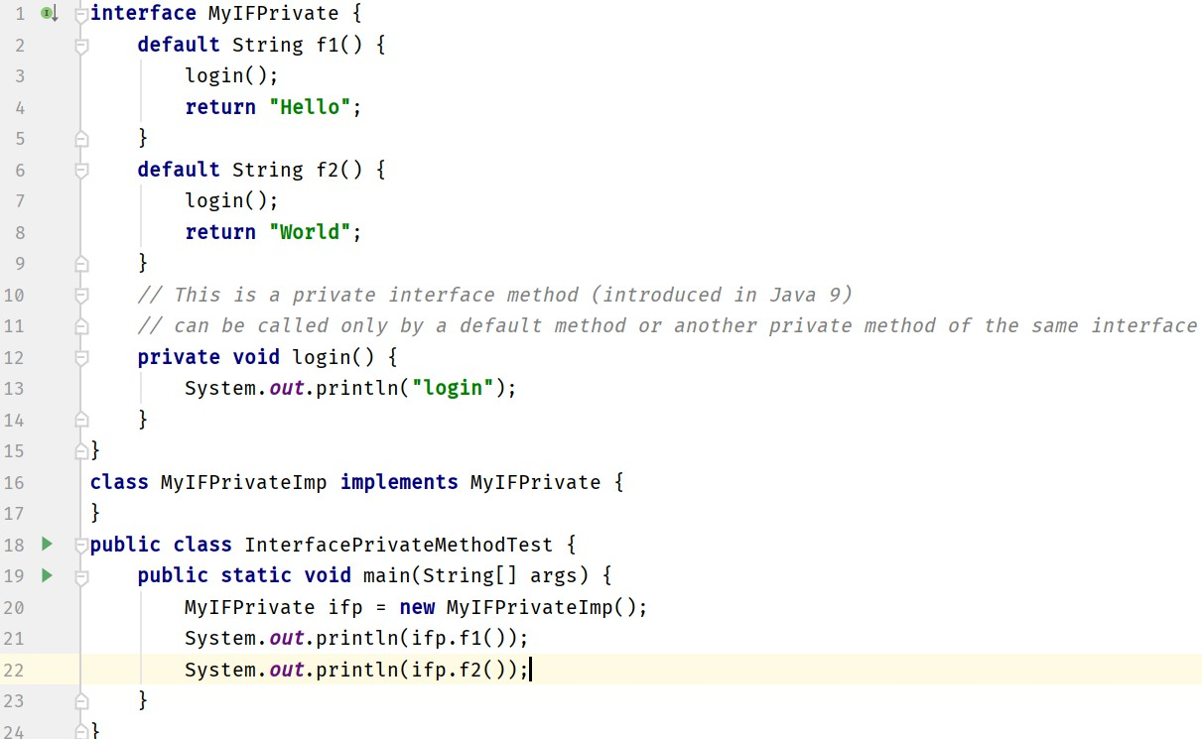
Private Methods in Interface
Notes:
Overview of new or updated electives.
Alignment with emerging technologies and industry requirements.

Slide 26
Private Methods in Interface
Notes:
Overview of new or updated electives.
Alignment with emerging technologies and industry requirements.

Slide 27
Exception Handling

Slide 28
Exception Handling
Handles runtime errors in a structured way.
Prevents abrupt program termination.
Provides error information to the user.
Notes:
Overview of new or updated electives.
Alignment with emerging technologies and industry requirements.

Slide 29
Types of Exception
Checked Exceptions: checked at compile time (e.g., IOException).
Unchecked Exceptions: occur at runtime (e.g., ArithmeticException).
Notes:
Overview of new or updated electives.
Alignment with emerging technologies and industry requirements.

Slide 30
Exception Handling keywords
try: defines risky code block.
catch: handles the exception.
throw: manually throws an exception.
throws: declares possible exceptions in method.
finally: always executes, used for cleanup.
Notes:
Overview of new or updated electives.
Alignment with emerging technologies and industry requirements.

Slide 31
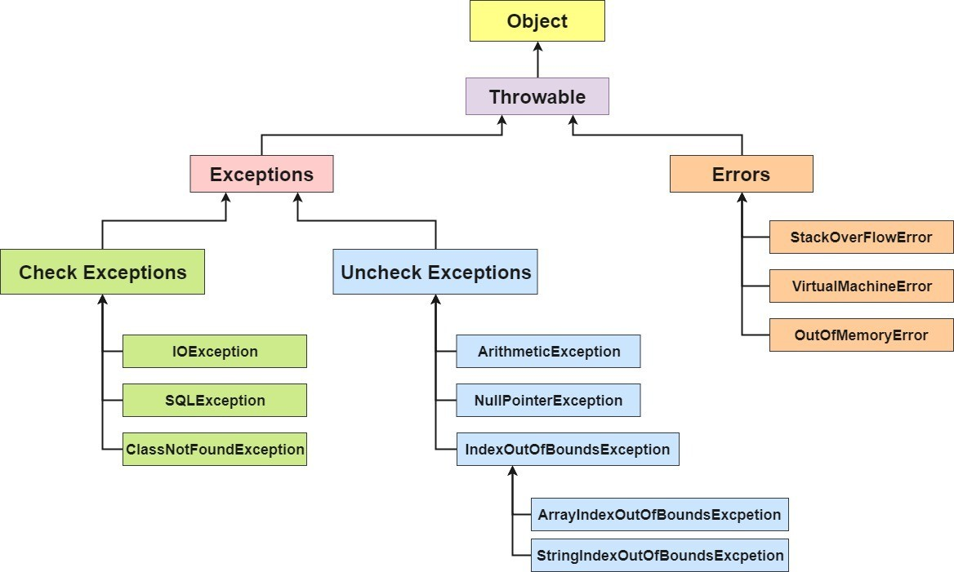
Exception Classes Hierarchy
Notes:
Overview of new or updated electives.
Alignment with emerging technologies and industry requirements.

Slide 32
Example code
try { int a = 10 / 0; }
catch (ArithmeticException e) { System.out.println('Cannot divide by zero'); }
finally { System.out.println('End of program'); }
Notes:
Overview of new or updated electives.
Alignment with emerging technologies and industry requirements.

Slide 33
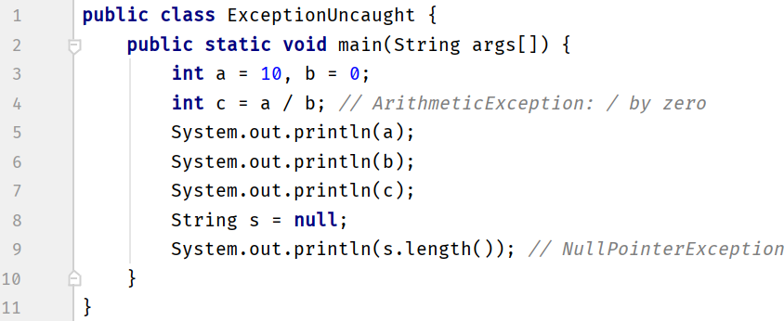
Uncaught Exception
Notes:
Overview of new or updated electives.
Alignment with emerging technologies and industry requirements.

Slide 34
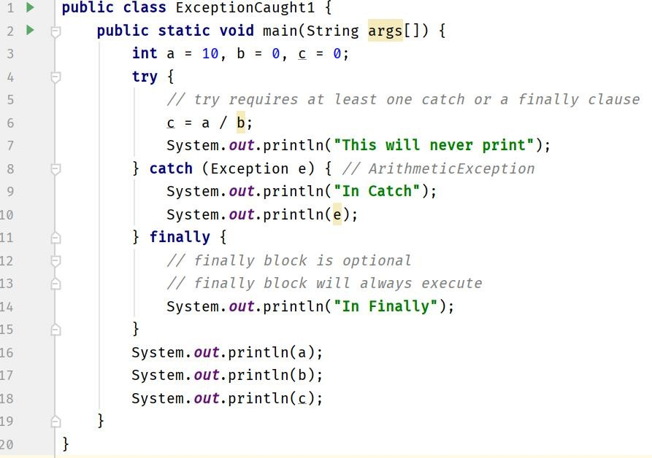
Caught Exception
Notes:
Overview of new or updated electives.
Alignment with emerging technologies and industry requirements.

Slide 35
Caught Exception
Notes:
Overview of new or updated electives.
Alignment with emerging technologies and industry requirements.

Slide 36
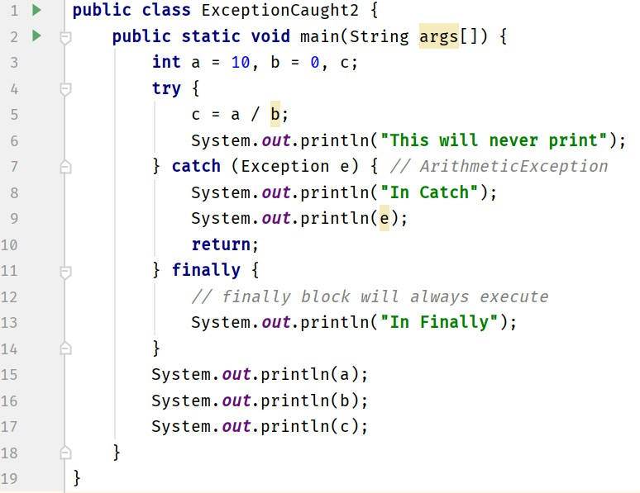
finally
Notes:
Overview of new or updated electives.
Alignment with emerging technologies and industry requirements.

Slide 37
finally
Notes:
Overview of new or updated electives.
Alignment with emerging technologies and industry requirements.

Slide 38
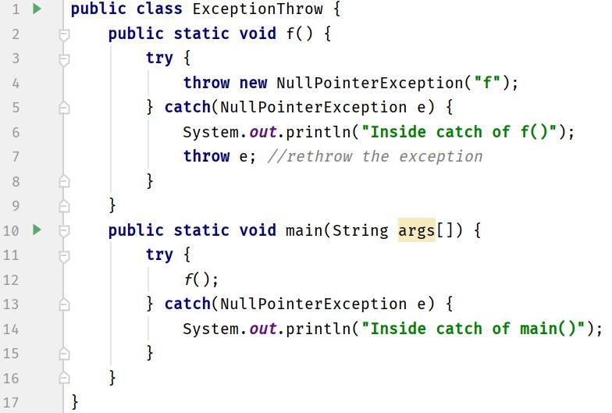
throw
Notes:
Overview of new or updated electives.
Alignment with emerging technologies and industry requirements.

Slide 39
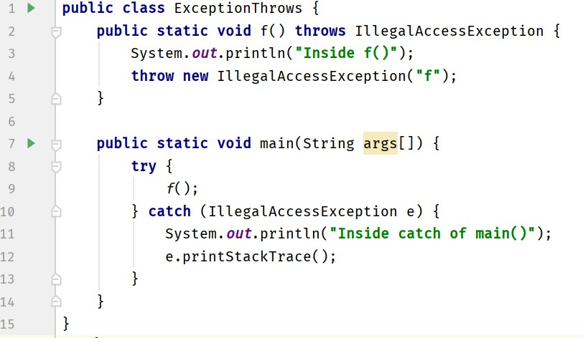
throws
Notes:
Overview of new or updated electives.
Alignment with emerging technologies and industry requirements.

Slide 40
throws
Notes:
Overview of new or updated electives.
Alignment with emerging technologies and industry requirements.

Slide 41
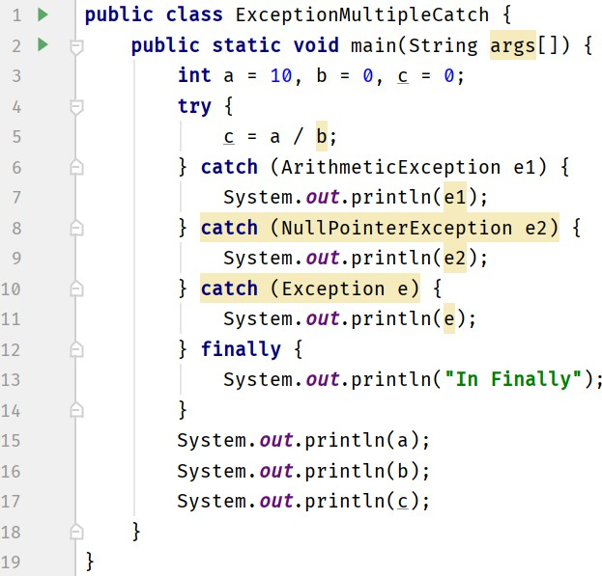
Multiple Catch Clauses
catch(ArithmeticException | NullPointerException e)
catch(ArithmeticException | Exception e) - Error
Notes:
Overview of new or updated electives.
Alignment with emerging technologies and industry requirements.

Slide 42
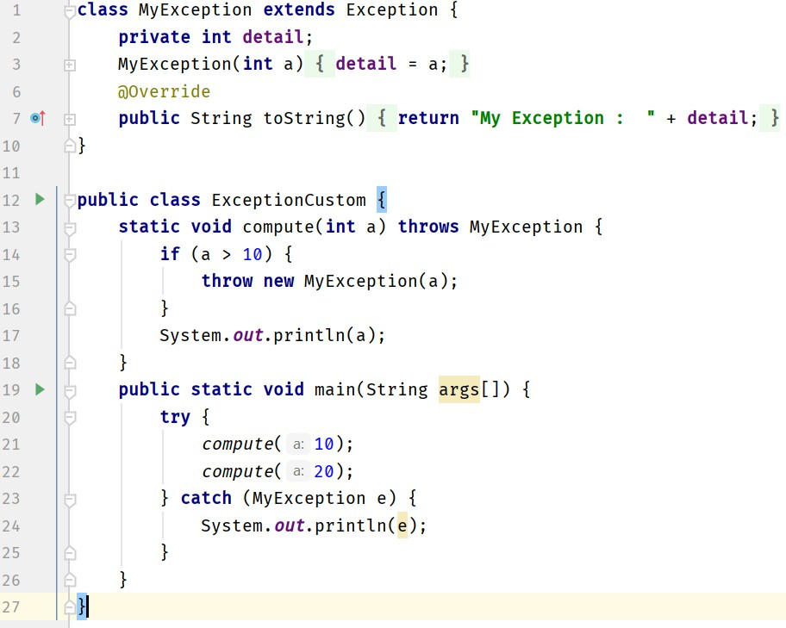
Custom Exceptions
Notes:
Overview of new or updated electives.
Alignment with emerging technologies and industry requirements.

Slide 43
Summary
Packages group related classes and interfaces.
Interfaces allow abstraction and multiple inheritance.
Exception handling makes programs robust.
Keywords: try, catch, throw, throws, finally.
Notes:
Overview of new or updated electives.
Alignment with emerging technologies and industry requirements.

